Slide 1
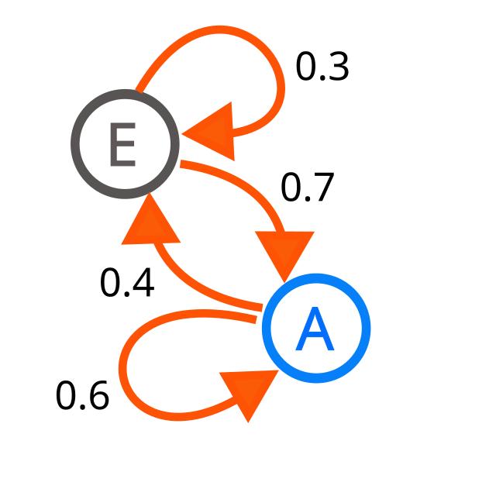
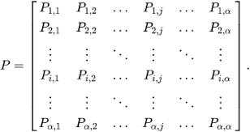
MATH 444- Undergrduate Research Project

Slide 2
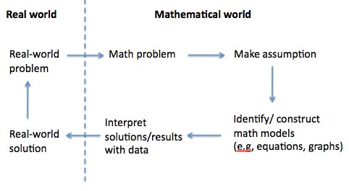
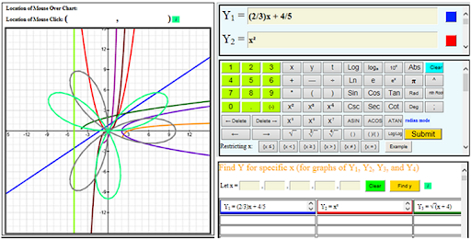
Title: Markov Chain: Modeling and Simulations
Advisor: Dr. Mokhtar Aouina

Slide 3
Objectives of this presentation
1) Study the important properties of finite Markov chains
2) Discuss algorithms to compute the state vector at any time and program it using Python to find a stationary distribution vector. In particular, find pertinent information about a system under study.
3) Analyze real situations that can be modeled by Markov chains such as Weather Transitions, Illness problems, Cyclic Random Walks, complex 7-state system(s) and simulating them using Monte-Carlo simulations.

Slide 4

Part-1 Weather Problem

Slide 5
Part 1-Weather Problem
“Here in Illinois, we all know how unpredictable the weather is. Today someone could be wearing shorts and a t-shirt, the next day you’ll see them bundled up in a Winter coat.
Wouldn’t it be nice if we could look past the daily fluctuations, and predict the weather in the long-term? Say a week from now, a month from now, or even a year from now?
Imagine a system where the weather today determines the probabilities of tomorrow's weather. This transition dependence is well-modeled using a Markov Chain.
But before we delve deeper into what a Markov Chain is, let’s look at an example of a Markov Chain.

Slide 6
Part-1 Weather Problem
Question: Assume the weather in Macomb today is one of 3 things (Nice, Rain, or Snow). You want to predict what are the probabilities of weather being tomorrow given today is a certain state.
If today the weather is nice, the probability of tomorrow being nice, rainy, and snowy are 0.7, 0.2 and 0.1 respectively. If today the weather is rainy, the probability of tomorrow being nice, rainy, and snowy are 0.5, 0.3, and 0.2 respectively. If today is snowy, the probability of being nice, rainy, and snowy tomorrow are 0.3, 0.3, and 0.4 respectively.
Now based on this information, let’s say it is snowing today, what will be the probabilities of being nice, rainy, and snowy, say after 5 days, 100 days, and even a year from now?
This question can be answered by studying the transition matrix associated to this problem, that can be visualized using a Markov Chain diagram. But first, what’s a Markov Chain?

Slide 7
Part 1- Weather Problem
A Markov Chain is a type of stochastic process that satisfies the Markov property, which is the property of "memorylessness.“ But, first what’s a stochastic process?
A stochastic process is a sequence of random events that unfold over time. It can be thought of as a collection of random variables that evolve step by step, starting at time t=0, t=1, and t=2, and so on. These events take place within a fixed set of possible outcomes, called the state space M.
Some stochastic processes have a special property called memorylessness, meaning the next step depends only on the current state, not on the past history of the MC. As stated before, such processes are called Markov Chains.
If we assume two additional properties:
The state space M has a limited number of possible states (it’s finite).
The transition probabilities (the chances of moving from one state to another) don’t change over time, meaning the process is homogeneous.
Then, the process is called a finite Markov Chain.

Slide 8


Part 1-Weather Problem
A transition matrix is a mathematical representation of the probabilities of moving from one state to another in one step in a Markov Chain summarized in a matrix. It captures all the possible transitions between states in a compact form, making it an essential tool for analyzing Markov Chains.
A Markov Diagram is a visual representation of a Markov Chain that shows the states and the probabilities of transitioning between them. It is essentially a directed graph where:
Nodes represent state of the Markov Chain
Arrows represent transition between states with associated probabilities
All the transition matrices in our examples will be column stochastic matrices. A column stochastic matrix is a square matrix where each column represents a probability distribution vector. This means the entries in each column are non-negative and sum to 1.

Slide 9
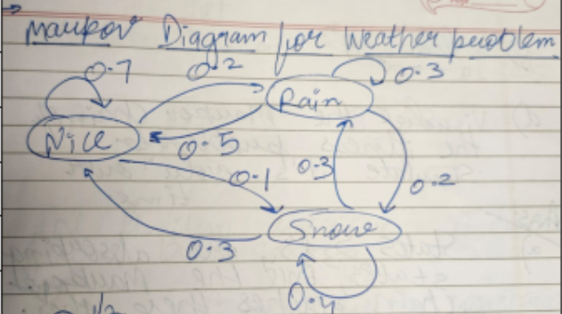
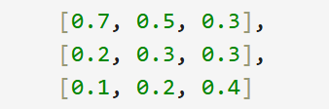
Part 1-Weather Problem
This is how we will visualize the transition matrix into a Markov Diagram
Let’s look at the transition matrix for our weather problem:

Slide 10
Part 1- Weather Problem
Before we delve deeper into the MC modelling the weather problem, let’s look at some important notation.
X(n) is the probability of being in different states on day n (or after n transitions).
X(0) is the initial state vector (the beginning state).
Based on the Memoryless property of Markov Chains, we can write X(n) as:
X(n+1)=A*X(n)= A^{n} *X(0) [Show proof for A*X(n)] [A^{n} *X(0) can be derived through induction.]
Now there is a 2nd formula for calculating X(n). It takes into account the assumption, that the matrix is diagonalizable.
Instead of relying on the state before it X(n-1) or the nth power of A, this method takes advantage of the eigenvalues and eigenvectors of the transition matrix A.

Slide 11
Part 1-Weather Problem
Let’s look at how we derived it (derivation):
The benefit of this formula over the 1st formula is that, once we have the eigenvalues, we don’t have to calculate large powers of A, that’s very computationally expensive. Instead we can just raise each eigenvalue to the power n and multiply by the corresponding eigenvector.
The time-complexity of the 1st algorithm is quadratic or O(n²) while the time-complexity of the 2nd algorithms is just linear or O(n).
Before we look at the results of the simulation on Python, I would like to discuss a very important property of regular Markov Chains.
A regular matrix is a stochastic matrix where, after a finite number of steps (say k), all entries in A^{k} (kth power of A) become positive.
According to the Perron-Frobenius theorem, such matrices have a unique dominant eigenvalue (λ₁​=1) with a unique associated eigenvector, that is a positive probability vector called the stationary distribution (v1).

Slide 12

Part 1- Weather Problem
Theorem: Consider a MC with a regular transitional matrix A. Then the MC converges to a probability vector X called steady-state vector. Moreover, this steady state vector X is the stationary distribution V of A.
MC converges to X means for every X(0)
Let’s see mathematically why the Markov Chain transitions to a unique steady state vector (say v) after a large number of steps (n=∞ steps). [Proof]
The proof also suggests that as the matrix is repeatedly applied, the contributions of all other eigenvalues (with magnitudes less than 1) decay exponentially, at least for diagonalizable matrices, causing the Markov chain to converge to π.
The decay of eigenvalue contributions other than λ₁ ensures that any differences in X(0) are washed out over time. Thus the steady–state distribution only depends on the structure of the matrix (A) and not the X(0) for regular matrices.

Slide 13
Part 1- Weather Problem
Now let’s 1st look at a code that calculates the eigenvalues and eigenvectors of the transition matrix for the Weather problem, also tells us how and when each component converges. (Show code & visualizations)
So through the 1st code we can see the eigenvalues and the associated eigenvectors for this transition matrix. Particularly that the largest eigenvalue is 1 and the other eigenvalues are less than 1.
Finally we will look at a Monte-Carlo Simulation for the weather problem, and see what’s the long-term distribution for this MC, based on different initial state vectors. (Show Code & visualizations)
A Monte-Carlo simulation is a computational technique, in the context of a random walk, it refers to simulating a sequence of steps, where each step is determined probabilistically based on predefined rules. It can be used to study long-term distributions in stochastic systems.

Slide 14
Part 1- Weather Problem
Randomization ensures that each trial reflects the system’s stochastic nature, generating a realistic sample path.
The Law of Large Numbers ensures that the average result of many trials approximate the theoretical probabilities.
Let’s discuss the interpretation of the Monte-Carlo result. We get that in the long-term there’s a roughly 58% chance for nice weather, 24% chance for rain, and 18% chance for snow represent the fraction of time the MC spends in each state. Thus it doesn’t matter if the weather today is nice, snowy, or rainy, the weather in the long-term will have the above-mentioned probabilities.
Another way of looking at it is to think that if we have 100 days, 58 of them will have nice weather, 24 will have rainy weather, and 18 will have snowy weather.
Thus, for regular matrices, like the one in weather problem, the simulation supports that there will only be 1 unique steady state distribution (independent of the initial state) .

Slide 15
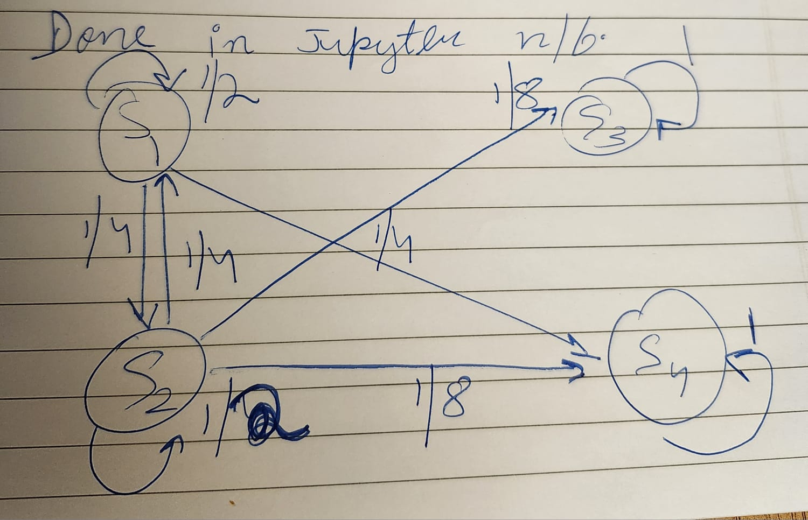
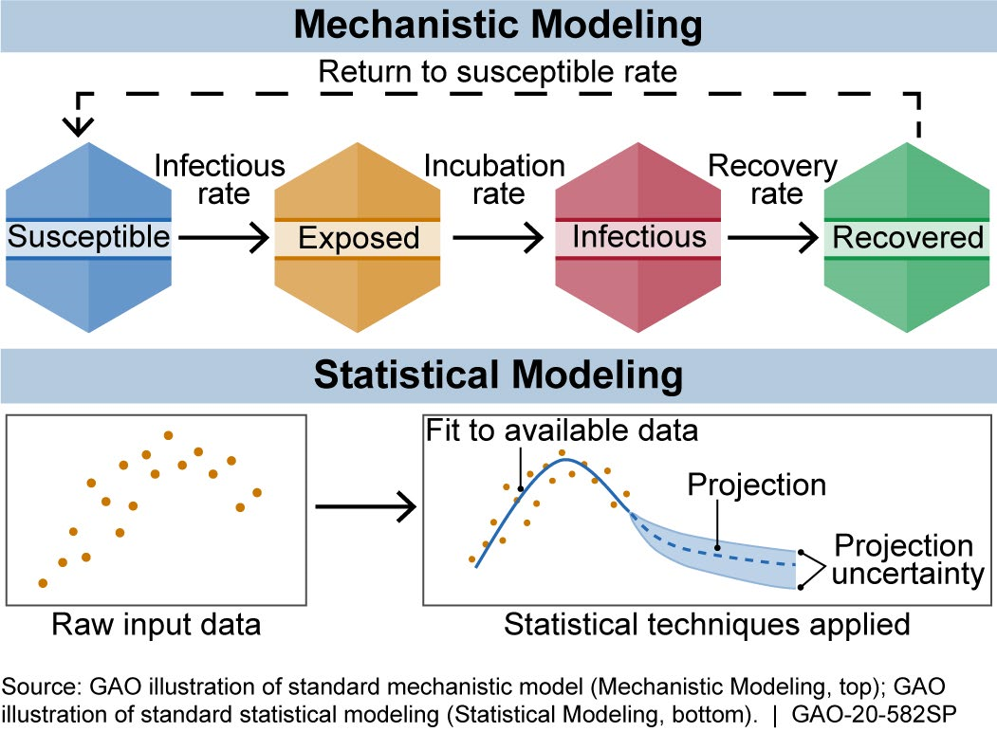
Part 2- Illness Problem
Now let’s look at a different kind of MC. An illness death model is described by a 4-state MC in which S₁ describes the state in which the person is illness free. S₂ describes the state when the person contracts the illness. S₃ defines the state where the person dies due to illness related causes, and S₄ finally is the state where the person dies due to non-illness related causes.
Let’s look at the MC diagram for this problem:

Slide 16
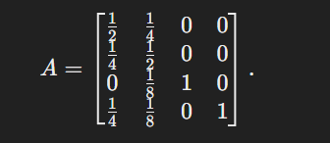
Part 2-Illness Problem
Here it’s interesting to note that if a person is healthy they can’t die of the disease, so they can’t go from S₁ to S₃. If a person is in state S₂, they can go to all states. However, if a person is in S₃ or S₄, they can’t go to other states of course, as they’re dead.
Let’s look at the associated transition matrix for the illness problem (let’s say A):
Before we discuss the evolution and other analysis of this MC, let’s look at some important properties/terminology.

Slide 17
Part 2-Illness Problem
State J is said to be accessible from state I if there exists a positive probability of reaching J starting from I in a finite number of steps. (It’s not required for state J to be directly connected to State I).
Two states I,J are said to communicate, if they’re accessible from each other.
Fact: Communication is an equivalence relationship on the state set S.
As a consequence of this fact, MCs are partitioned into communicating classes. Only the members from the same class can communicate with each other.
For example, based on this MC we have 3 communicating classes: {S₁,S₂},{S₃},{S₄}.

Slide 18
Part 2-Illness Problem
Let’s look at the last set of definitions before we analyse problem 2 more closely.
A state i is transient if there is a path starting at i, but will never return to i. For example, states S1 and S2 are transient, because after we leave them, we might end up in S3 and S4, where we can’t exit from.
A state is referred to as an absorbing state, if once entered, cannot be exited. Here S3 and S4 are absorbing states. So once we enter S3 and S4, we will stay there forever.
A state is said to be recurrent, if after leaving that state, there’s a guaranteed path to take us back again at least once.
S1 and S2 are not recurrent since they are transient.
Absorbing states such as S3 and S4 are always recurrent, because once we reach them, we can revisit them an infinite number of times.
A MC is irreducible, if all states can communicate with each another.
Our MC for the illness problem is non-irreducible, but for the weather problem it is irreducible.

Slide 19
Part 2-Illness Problem
Now let’s look at the results of the eigenvalue and eigenvectors of this MC. [Show the code for Eigenvalue and Eigenvectors]
[Also look at the results of MC simulation]
Here we get 2 distinct long-term distributions that are achieved when we start at state S1 and S2 respectively. This means that the steady-state distributions are no longer independent of the initial state. This is different from what we saw in the weather problem, where there was only 1 unique steady state independent of the initial state.
We conjecture that our MC doesn’t converge in our sense due to the non-irreducibility of the illness MC, in contrast to the weather MC.
If we look at the paths involved in the steady-state distribution (for say X(100)), we will realize that we are in S1 and S2 only for the beginning few transitions, and in the long-term, the system spends a majority of the time in S3 or S4. This is because S1 an S2 are transient states, and S3 and S4 are absorbing states.

Slide 20
Part 2-Illness Problem
If someone starts at S3 or S4, they will remain there with a probability 1, since they are absorbing states.
Now let’s look at the interpretation of the steady-state distributions for each initial state:
Starting at S1 (healthy): This is an approx. of the result of the Monte-Carlo simulations: [0,0,0.17,0.83] A person has an 83% chance of dying from other causes and a 17% chance of dying from the illness.
Starting at S2​ (ill): This is an approx. of the result of the Monte-Carlo simulations: [0,0,0.33,0.67]
A person has a 67% chance of dying from other causes and a 33% chance of dying from the illness.
Starting at S3​ (death from illness): Once death from illness occurs, the person is absorbed into state S3, and no further transitions happen.
Starting at S4(death from other causes): Once death from other causes occurs, the person is absorbed into state S4, and no further transitions happen.
This model shows that while the illness is a factor in mortality, other causes of death are more significant, and prevention of those other causes may play an even larger role in improving survival rates for the population. The mortality rate of the actual illness might not be that high, however, more research is required to understand the complex factors.

Slide 21
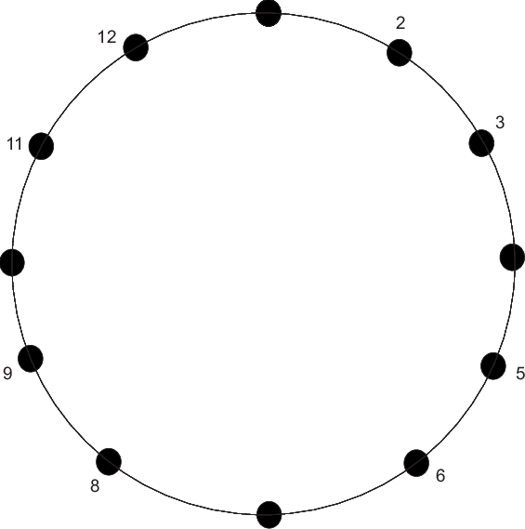
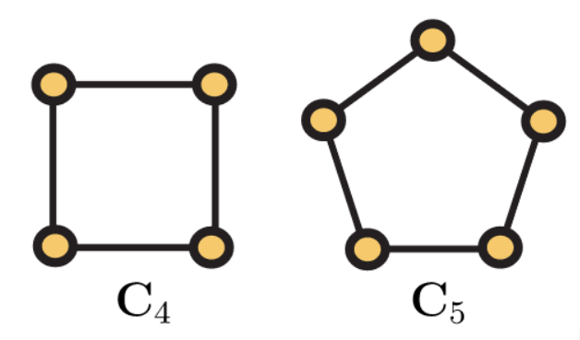
Part 3- Cycles (C4 and C5)

Slide 22

Part 3-Cycles
A state i in a MC is said to be periodic with period d, if we can visit it at multiples of a fixed number of d steps.
The period d can then be defined as the gcd {n|(A^{n})_{ii} >0} where n is the number of steps required to reach state i and A is the transitional matrix of the MC.
For example: For this MC, each state has period d=2, and we say that the MC is periodic with period 2.
If d=1, then the state i is said to be aperiodic.
For example in our illness problem, all the 4 states are aperiodic, because there isn’t a fixed/repeating pattern that allows us to revisit a node again and again. The illness problem is an example of a MC that is aperiodic, because all of its states are aperiodic.

Slide 23
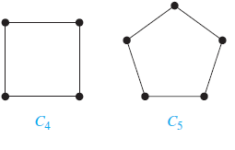
Part 3-Cycles (C4 and C5)
A cycle graph C_{n​} consists of n nodes connected in a closed loop. Each node has exactly two neighbors. Thus, C4 and C5 make a graph with 4 and 5 nodes each respectively.
Let’s look at what a C4 and a C5 system will look like:
We are going to look at 2 different cases of C4 and C5 each. The unidirectional case and the bidirectional case. Let’s see what it means.
When a cycle is bidirectional, it means that each node can go to the nodes before and after it with equal probability. When a cycle is unidirectional, it means that that each node can only go the node before or after it (based on the direction of cycle).

Slide 24
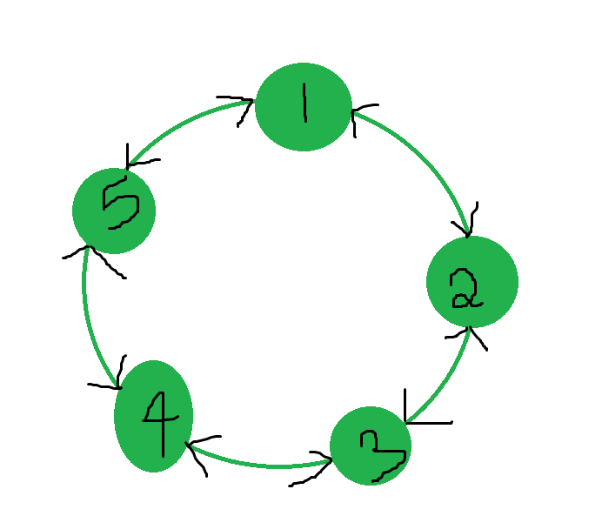
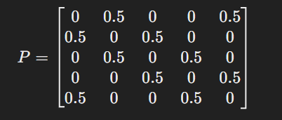
Part 3- Cycles (C4 and C5)
First we are going to focus on the C5 case, particularly the bidirectional case and then the unidirectional case.
Let’s look at the matrix for the bidirectional C5 case. It will look something like this:
As you can see here, this matrix has equal probability (0.5) for each node to travel to the node before it or after it.
We will look at the long-term distribution for this particular MC, i.e. discuss its convergence. [Show eigenvalue and eigenvector results]

Slide 25
Part 3- Cycles (C4 and C5)
Also, if we look at the distribution for X(100) for all the starting points, 1 through 5, we always get the same steady-state distribution. Thus the steady state distribution is independent of the initial-state vector.
These results can also be verified with the Monte-Carlo simulation for this matrix! [Show the random walk results]
Moreover, the steady state for this matrix converges to a unique-steady state vector, where each component is 0.2, which equals 1/5, where 5= # of states.

Slide 26
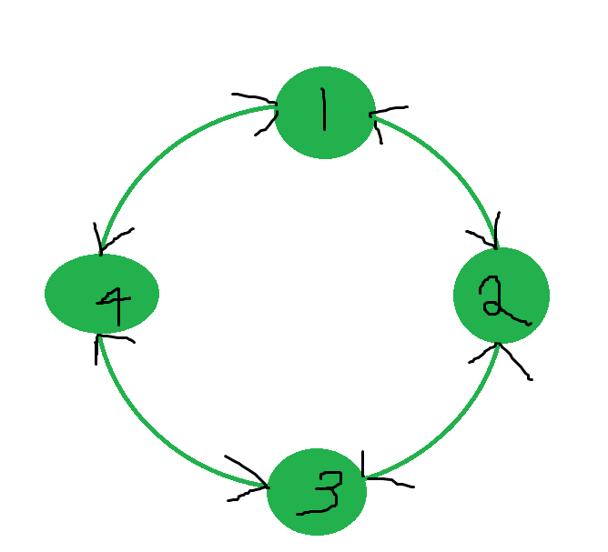
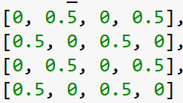
Part 3- Cycles (C4 and C5)
Let’s look at the results for C4 bidirectional case. Then we will compare them! [Show eigenvalue and eigenvector results for C4 bidirectional]

Slide 27
Part 3-Cycles (C4 and C5)
Let’s look at the convergence for the C4 bidirectional case. [Show convergence for C4 bidirectional case]
Based on the results starting from state 1, we have 2 distinct steady-state distributions: [0,0.5,0,0.5] and [0.5,0,0.5,0].
These 2 steady-state distributions correspond to large values of n even and n odd respectively.
The MC oscillates between those 2 steady-state distributions. Moreover, this long run oscillation of the MC also depends on the initial state vector.
For example, if we start at, say state 1, and run for 100 times, we will end up at either state 2 or 4 with equal probability of 0.5
But if we start at, say state 2, and run for 100 times, we will end up at either state 1 or 3 with an equal probability of 0.5.
Similarly if we start at state 1/state 2 with n=99 instead, we will alternate between the steady-state distributions.
Let’s see what they look like in a visualization. [Show visualization for components of states in steady-state].

Slide 28
Part 3-Cycles (C4 and C5)
It’s very important to note that in the C5 bidirectional case, the MC is aperiodic, this is due to the equal probability of ending up in either direction. However, in the C4 bidirectional case, the MC is periodic (with period=2).
We conjecture that MC of C4 bidirectional doesn’t converge in our sense due to the periodicity of the MC, in contrast to the MC of C5 bidirectional that is aperiodic.

Slide 29
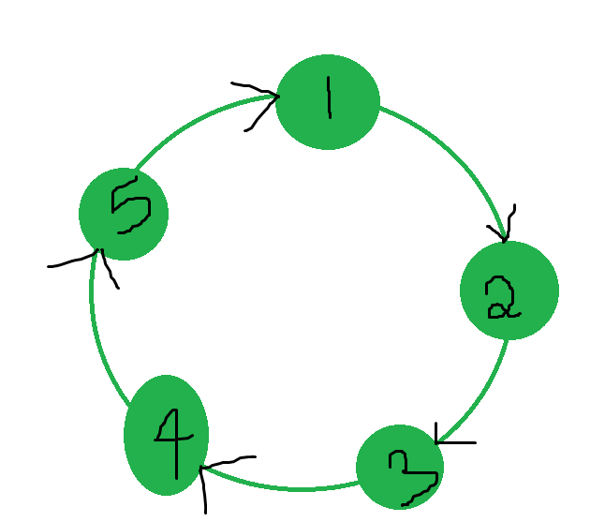
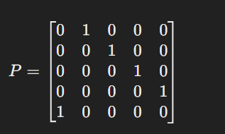
Part 3-Cycles (C4 and C5)
Okay so for the C5 unidirectional case, the matrix will look something like this:
We will look at the long-term distribution for the C5 unidirectional MC, i.e. discuss its convergence. [Show eigenvalue and eigenvector results]
[Show the 5 files for C5 unidirectional.]

Slide 30
Part 3-Cycles (C4 and C5)
Let’s look at the convergence for the C5 unidirectional MC. [Show convergence for C5 unidirectional case]
Based on the results starting from state 1, we have 5 distinct steady-state distributions: [1,0,0,0,0], [0,1,0,0,0], [0,0,1,0,0], [0,0,0,1,0], and [0,0,0,0,1]
These 5 steady-state distributions correspond to the 5 values of n mod 5.
The MC oscillates between those 5 steady-state distributions. Moreover, this oscillation of the MC also depends on the initial state vector.
For example, if we start at, say state 1, and run for 5n times, we will end up at state 1.
But if we start at, say state 2, and run for 5n times, we will end up at state 2
Similarly, starting at state 1 (resp. 2), and if we run 5n+1, 5n+2, 5n+3, and 5n+4 times resp., we will end up at states 5 (resp. state 1), 4 (resp. 5), 3 (resp. 4), and 2 (resp. 3) respectively.

Slide 31
Part 3-Cycles (C4 and C5)
Similar results are true for C4 unidirectional MC.
Both C5 and C4 unidirectional MCs do not converge in our sense.
C5 and C4 unidirectional MCs have periods 5 and 4 respectively.
We conjecture that MC of C4 and C5 unidirectional do not converge in our sense due to the periodicity.

Slide 32
Conclusions Based on Parts 1,2, and 3
Both non-irreducibility and periodicity are obstructions for a MC to be regular.
Theorem:
A Markov Chain is regular
if and only if
The Markov Chain is both irreducible and aperiodic.

Slide 33
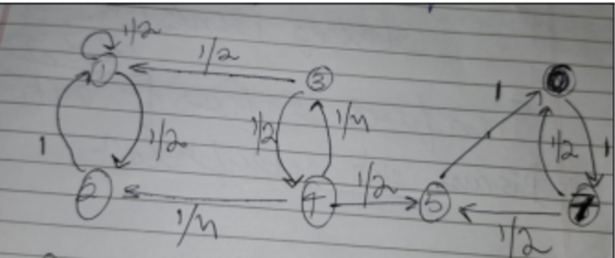
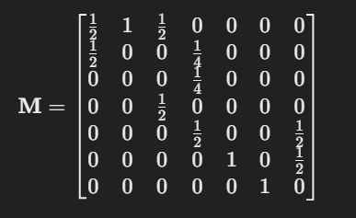
Part 4- 7 State Problem
Now we are going to look at a problem with 7 states, let’s see its transition matrix and its MC diagram.
As you can see that this matrix with 7 states, is more complex than other problems we have looked at until now.
Let’s try to analyse the 7-state MC and understand its end behaviour and its important properties.
Let’s look at the eigenvalues for this problem. [Show eigenvalues and eigenvectors]

Slide 34
Part 4- 7 State Problem
As you can see, this MC is not irreducible and is aperiodic, therefore, it’s not a regular MC. Thus, it will not converge in our sense.
Let’s look at the convergence of this MC when we start at state 3.
[Show results of 3 simulations for state 3 and Monte-Carlo]
[Talk about the interpretation of the results for state 3]
Let’s look at the convergence of this MC when we start at state 1.
[Show results for 3 simulations for state 1 and Monte-Carlo]
[Talk about the interpretation of the results for state 1]
Let’s look at the convergence of this MC when we start at state 5.
[Show results for 3 simulations for state 5 and Monte-Carlo]
[Talk about the interpretation of the results for state 5]
In general, if we start at a transient state 3 or 4, we will end up either in group 1 or group 2.

Slide 35
Part 4- 7 State Problem
Now we are going to end this discussion with a very interesting observation, where we divide the 1st and 2nd components of steady-state for state 3, by the corresponding 1st and 2nd components of steady-state for state 1.
After doing that, I get the ratios as 0.72.
I also divide the 5th,6th, and 7th components of state 3 with the corresponding 5th, 6th, and 7th components of state 5. I get the ratios as 0.28. [Show ratio of group 1 to group 2 for steady-states.]

Slide 36
Part 4-7 State Problem
Now let’s discuss the interpretation of these observations:
We are going to do Monte-Carlo simulation, where we tracks how many times the MC ended up in group 1 (recurrent communicating class with states 1 and 2) or group 2 (recurrent communicating class with states 5,6, and 7) for the 10000 simulations.
[Show results of relative frequencies for G1 and G2]
The results of the Monte-Carlo Simulations: The relative frequencies of being in group 1 or group 2 are, 0.7159 and 0.2843 respectively.
These relative frequencies represent the probabilities of the MC to be absorbed by G1 and G2 respectively, when we start at state 3.
Here the recurrent classes G1 and G2 act as absorbing classes, like the absorbing states in the illness problem.
Another take away is that if we start at transient states 3 or 4, the MC ends up being trapped either in G1 72% of the times or in G2 with 28%.

Slide 37
Conclusion
Markov Chains as a Modelling Tool:
Markov Chains provide a powerful framework to model dynamic systems like weather patterns, illness progression, cyclic structures, page-rank algorithms, management of retailer storage etc.
The study highlights how the study of the transitional matrix of the MC determines long-term system behavior along with their initial states.
Efficiency in Computation:
Discussed an eigenvalue-based algorithm to calculate state vectors efficiently, reducing computational complexity from quadratic (O(n²)) to linear (O(n)).
Demonstrated the practical application of these algorithms in real-world scenarios using Python codes.
Key Findings:
Systems with regular matrices converge to unique steady-state distributions, independent of initial states.

Slide 38
Conclusion
Applications in Diverse Domains:
This study lays a foundation for analyzing systems in meteorology, epidemiology, and network theory using Markov Chains.
Insights from absorbing and transient states can guide interventions in healthcare and urban planning.
Challenges and Opportunities:
Monte-Carlo simulations are helpful to analyze complex systems (like the 7-state problem), and present themselves as a practical substitutes for the other methods that are limited by example, if the size of the states is big.
Potential Future Explorations:
Explore Markov Chains with non-constant transition probabilities (non-homogeneous chains).
Investigate implications of complex eigenvalues in oscillatory systems for more nuanced applications in engineering and finance.

Slide 39
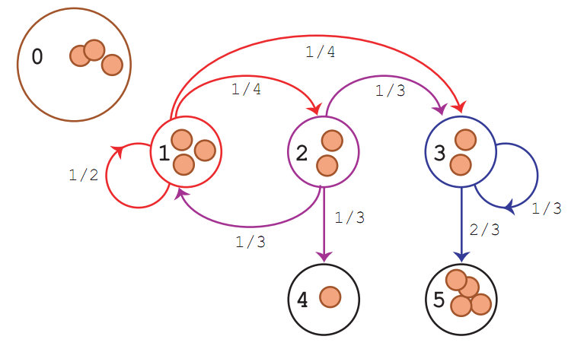
Takeaway Message
Markov Chains are not just mathematical abstractions; they offer actionable insights into dynamic processes, with profound implications across science and industry. This project exemplifies their potential and calls for continued exploration.

Slide 40


¿Questions and Answers?
A lot of information has been passed on your way during the last hour or so. Got any questions let me know (preferably not, make YOUR and MY life easier! Save energy!)
Just kidding!
Please ASK AWAY!!!

Slide 41


THANK YOU!
Yup that’s right, now we all can go, thank god! Phewwwww…………..

